Slide 1
Object Oriented Programming using Java - Inheritance Overview

Slide 2
Introduction
Inheritance
Software reusability
Create new class from existing class
Absorb existing class’s data and behaviors
Enhance with new capabilities
Subclass extends superclass
Subclass
More specialized group of objects
Behaviors inherited from superclass
Can customize
Additional behaviors

Slide 3
Introduction (Cont.)
Class hierarchy
Direct superclass
Inherited explicitly (one level up hierarchy)
Indirect superclass
Inherited two or more levels up hierarchy
Single inheritance
Inherits from one superclass
Multiple inheritance
Inherits from multiple superclasses
Java does not support multiple inheritance

Slide 4
Superclasses and subclasses
Superclasses and subclasses
Object of one class “is an” object of another class
Example: Rectangle is quadrilateral.
Class Rectangle inherits from class Quadrilateral
Quadrilateral: superclass
Rectangle: subclass
Superclass typically represents larger set of objects than subclasses
Example:
superclass: Vehicle
subclass: Car
Smaller, more-specific subset of vehicles

Slide 5
Fig. 9.1 | Inheritance examples.

Slide 6
Superclasses and subclasses (Cont.)
Inheritance hierarchy
Inheritance relationships: tree-like hierarchy structure
Each class becomes
superclass
Supply members to other classes
OR
subclass
Inherit members from other classes

Slide 7
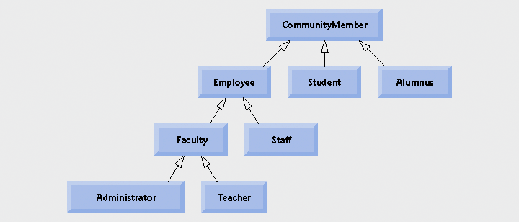
Fig. 9.2 | Inheritance hierarchy for university CommunityMembers

Slide 8
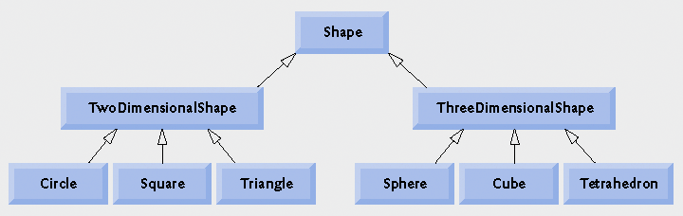
Fig. 9.3 | Inheritance hierarchy for Shapes.

Slide 9
Relationship between Superclasses and Subclasses
Superclass and subclass relationship
Example: CommissionEmployee/BasePlusCommissionEmployee inheritance hierarchy
CommissionEmployee
First name, last name, SSN, commission rate, gross sale amount
BasePlusCommissionEmployee
First name, last name, SSN, commission rate, gross sale amount
Base salary

Slide 10
Creating and Using a CommissionEmployee Class
Class CommissionEmployee
Extends class Object
Keyword extends
Every class in Java extends an existing class
Except Object
Every class inherits Object’s methods
New class implicitly extends Object
If it does not extend another class

Slide 11
Common Programming Error 9.1
It is a syntax error to override a method with a more restricted access modifier—a public method of the superclass cannot become a protected or private method in the subclass; a protected method of the superclass cannot become a private method in the subclass. Doing so would break the “is-a” relationship in which it is required that all subclass objects be able to respond to method calls that are made to public methods declared in the superclass.(cont…)

Slide 12
Common Programming Error 9.1
If a public method could be overridden as a protected or private method, the subclass objects would not be able to respond to the same method calls as superclass objects. Once a method is declared public in a superclass, the method remains public for all that class’s direct and indirect subclasses.

Slide 13
protected Members
protected access
Intermediate level of protection between public and private
protected members accessible by
superclass members
subclass members
Subclass access to superclass member
Keyword super and a dot (.)

Slide 14
CommissionEmployee-BasePlusCommissionEmployee Inheritance Hierarchy Using protected Instance Variables
Use protected instance variables
Enable class BasePlusCommissionEmployee to directly access superclass instance variables
Superclass’s protected members are inherited by all subclases of that superclass

Slide 15
Outline
Declare private instance variables
Commission
Employee3.java
(1 of 4)
Lines 6-10

Slide 16
Outline
Commission
Employee3.java
(2 of 4)

Slide 17
Outline
Commission
Employee3.java
(3 of 4)

Slide 18
Outline
Use get methods to obtain the values of instance variables
Commission
Employee3.java
(4 of 4)
Line 87
Lines 94-97

Slide 19
Outline
BasePlusCommissionEmployee4.java
(1 of 2)
Inherits from CommissionEmployee3

Slide 20
Outline
Invoke an overridden superclass method from a subclass
BasePlusCommissionEmployee4.java
(2 of 2)
Line 33 & 40
Line 33
Lines 40
Use get methods to obtain the values of instance variables
Invoke an overridden superclass method from a subclass

Slide 21
Common Programming Error 9.3
When a superclass method is overridden in a subclass, the subclass version often calls the superclass version to do a portion of the work. Failure to prefix the superclass method name with the keyword super and a dot (.) separator when referencing the superclass’s method causes the subclass method to call itself, creating an error called infinite recursion.

Slide 22
Outline
BasePlusCommissionEmployeeTest4.java
(1 of 2)
Lines 9-11
Lines 16-25
Create BasePlusCommissionEmployee4 object.
Use inherited get methods to access inherited private instance variables
Use BasePlusCommissionEmployee4 get method to access private instance variable.

Slide 23
Outline
Use BasePlusCommissionEmployee4 set method to modify private instance variable baseSalary.
BasePlusCommissionEmployeeTest4.java
(2 of 2)

Slide 24
Object Oriented Programming using Java - Inheritance Constructors

Slide 25
Software Engineering Observation 9.8
When a program creates a subclass object, the subclass constructor immediately calls the superclass constructor (explicitly, via super, or implicitly).
The superclass constructor’s body executes to initialize the superclass’s instance variables that are part of the subclass object, then the subclass constructor’s body executes to initialize the subclass-only instance variables

Slide 26
Constructors in Subclasses
Instantiating subclass object
Chain of constructor calls
subclass constructor invokes superclass constructor
Implicitly or explicitly
Base of inheritance hierarchy
Last constructor called in chain is Object’s constructor
Original subclass constructor’s body finishes executing last

Slide 27
Fig. 9.2 | Inheritance hierarchy for university CommunityMembers

Slide 28
Software Engineering Observation 9.8
Java ensures that even if a constructor does not assign a value to an instance variable, the variable is still initialized to its default value (e.g., 0 for primitive numeric types, false for booleans, null for references).

Slide 29
Constructor Calls…
There are some restrictions on how you can use the base class constructor call super .
Also, the call to the base class constructor ( super ) must always be the first action taken in a constructor definition. You cannot use it later in the definition of a constructor.
Notice that you use the keyword super to call the constructor of the base class. You do not use the name of the constructor; you do not use
Employee(theName, theDate); //ILLEGAL

Slide 30
Constructor Calls…
If a constructor definition for a derived class does not include an invocation of a constructor for the base class, then the no-argument constructor of the base class is invoked automatically as the first action of the derived class constructor.

Slide 31
Within the definition of a constructor for a class, you can use super as a name for a constructor of the base class. Any invocation of super must be the first action taken by the constructor.
EXAMPLE
public SalariedEmployee(SalariedEmployee originalObject)
{
super(originalObject);
salary = originalObject.salary;
}

Slide 32
Software Engineering Observation 9.10
At the design stage in an object-oriented system, the designer often finds that certain classes are closely related. The designer should “factor out” common instance variables and methods and place them in a superclass. Then the designer should use inheritance to develop subclasses, specializing them with capabilities beyond those inherited from the superclass.

Slide 33
Notes
The inherited fields can be used directly, just like any other fields.
You can declare a field in the subclass with the same name as the one in the superclass, thus hiding it (not recommended).
You can declare new fields in the subclass that are not in the superclass.
The inherited methods can be used directly as they are.
You can write a new instance method in the subclass that has the same signature as the one in the superclass, thus overriding it.
You can declare new methods in the subclass that are not in the superclass.
You can write a subclass constructor that invokes the constructor of the superclass, either implicitly or by using the keyword super.

Slide 34
Notes
A subclass does not inherit the private members of its parent class. However, if the superclass has public or protected methods for accessing its private fields, these can also be used by the subclass.

Slide 35
Object Class
All classes in java inherit directly or indirectly from the Object class (package jva.lang)
Class Object methods
clone
equals
finalize
getClass
hashCode
notify, notifyAll, wait
toString

Slide 36
An Object of a Derived Class Has More than One Type
An object of a derived class has the type of the derived class, and it also has the type of the base class.
More generally, a derived class has the type of every one of its ancestor classes.
So, you can assign an object of a derived class to a variable of any ancestor type (but not the other way around).
You can plug in a derived class object for a parameter of any of its ancestor types.
More generally, you can use a derived class object anyplace you can use an object of any of its ancestor types.

Slide 37
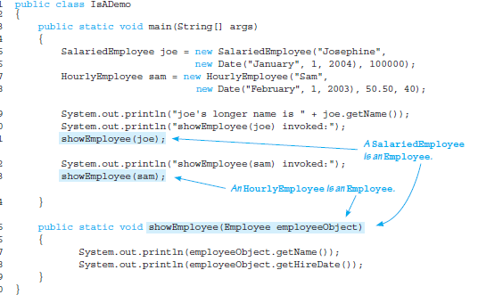

Slide 38
Private Methods Are Effectively Not Inherited
The private methods of the base class are just like private variables in terms of not being directly available.

Slide 39
Acknowledgements
Deitel, Java How to Program

